Slide 1

Student Course Management System
Presented by:
- Samir Adhikari
- Yubraj Bhattari
- Indra Bhahadur Kami
- Shahrodi Siam Rupom
This Photo by Unknown Author is licensed under CC BY

Slide 2
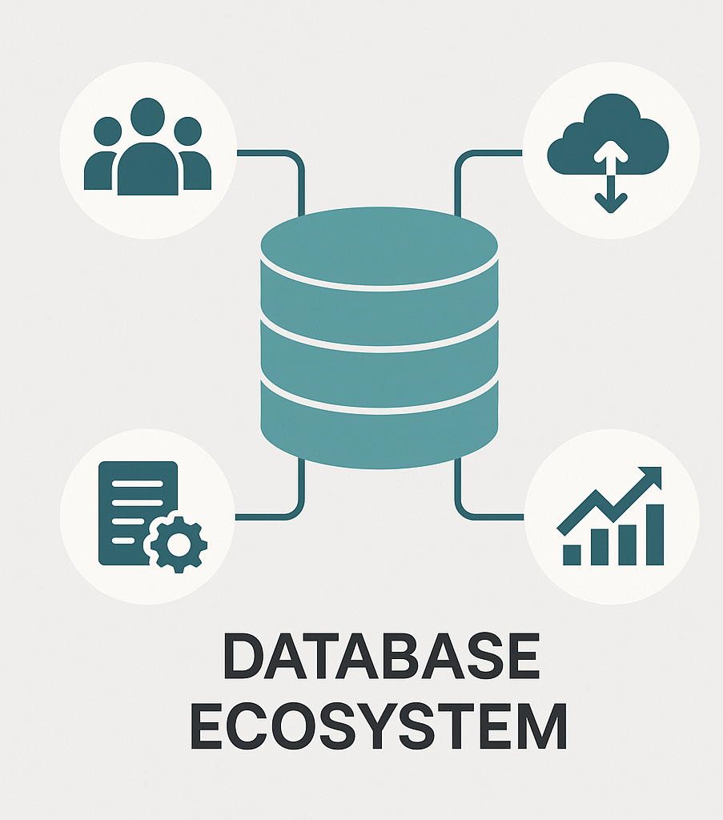
Project Objectives & System Purpose
Goal: Design a reliable and adaptable Student Course Management System.
Scope: Manages Student Enrollment, Course details, attendance records, grades, and teacher assignments.
Tools Used: MySQL (SQL), MongoDB (NoSQL), SmartDraw, VS Code.

Slide 3
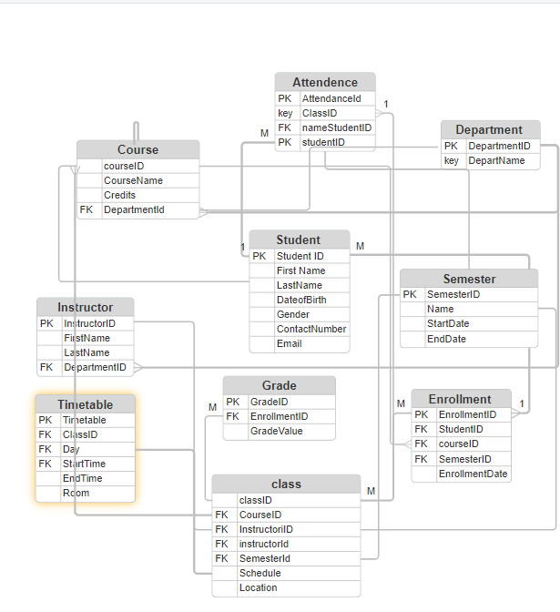
EERD and Relational Schema
Key entities: This database include core entities like Student, Course, Instructor, Enrollment, Grade, and Attendance.
Relationships: They are connected using M:N, 1:M, and entity specialization.
Normalization: The database has been normalized up to 3NF to reduce data redundancy and ensure data consistency.

Slide 4
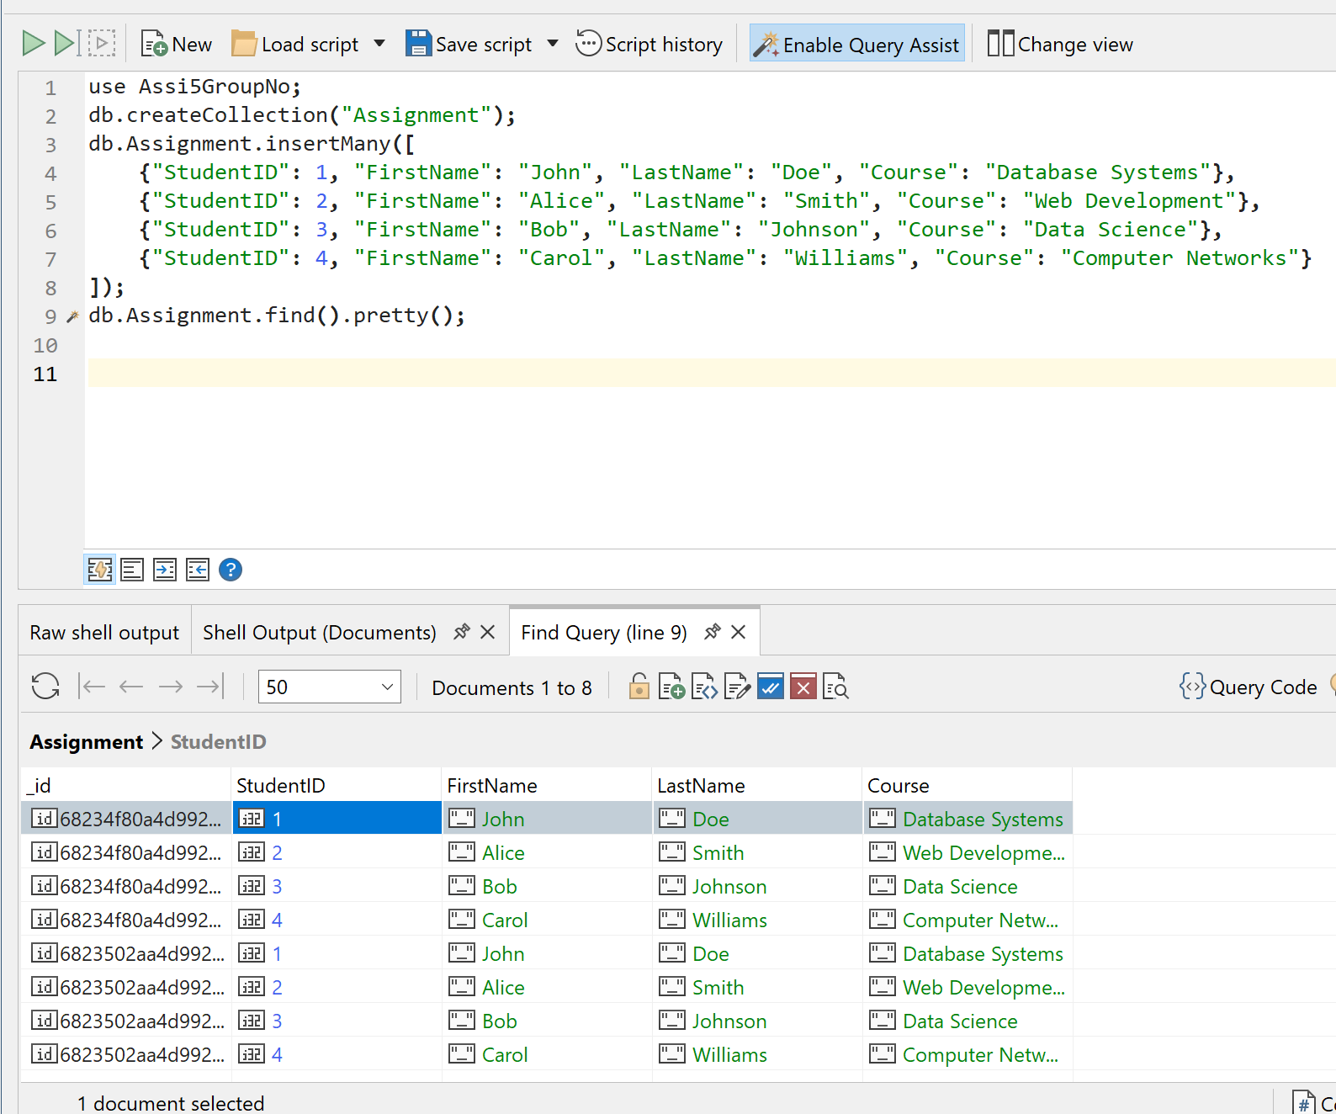
SQL and NoSQL Database Implementation
SQL (DDL & DML): Created eight foundational table and inserted some sample data via DML.
Sample Queries: Performed core queries such as SELECT, JOIN, INSERT, UPDATE, and DELETE.
NoSQL (MongoDB): Used MongoDB to store data as documents and executed updates using the updateOne() method.

Slide 5
Concurrency Control & Access Management
- Used role- based permissions to maintain secure access.
- Managed transaction to maintain consistent and accurate data.
- Conducted regular backup and checked for errors.

Slide 6

Reflection & Conclusion
Strengths: Effective collaboration, clear communication and clean data modeling.
Challenges: Manage time effectively and competing academic responsibilities.
Ethics: Ensured data privacy through secure access protocols.
Conclusion: The SCMS aims were achieved and with room for improvements in future.

Slide 7
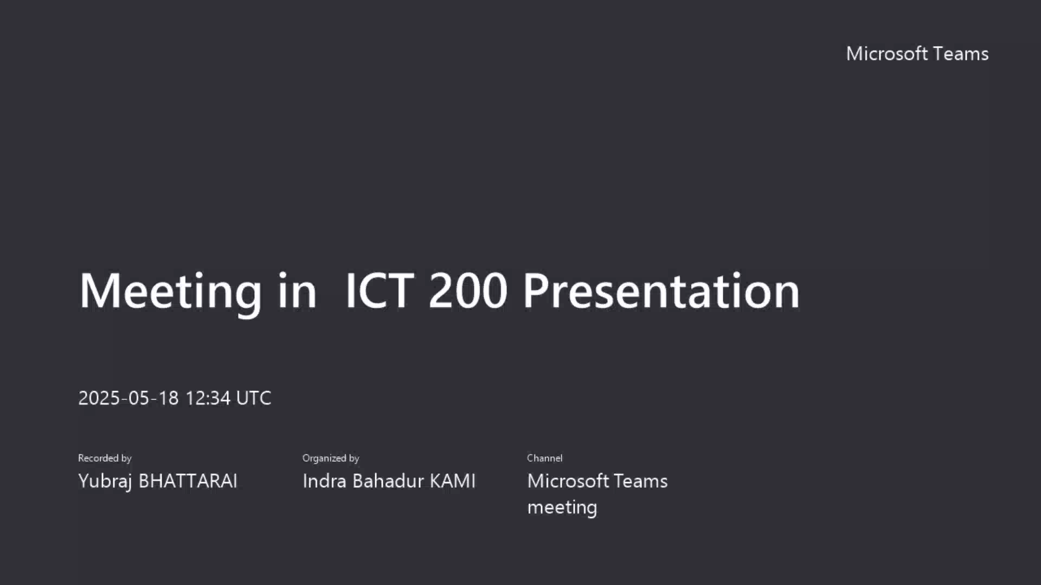
Meeting in ICT 200 Presentation-20250518_223356-Meeting Recording.mp4

